Slide 1

Code Marathon
R2P Platform
DevFins --- Victor & Barbara
Notes:
Welcome to join this session. We are from DevFins team, I am Victor, her name is Barbara.
DevFins means Development and Finance.
Our case is from GFS AO department for payment process issue.

Slide 2
Agenda
Current business workflow
New design
Performance improvement
Notes:
I will share you 3 points here.
The first one is current business workflow. In this chapter, I will show you what is the user doing and what’s the their problem.
The second one is new design. In this chapter, I will show you our new solution and how to fix user’s problem.
The last one I will show the performance.

Slide 3


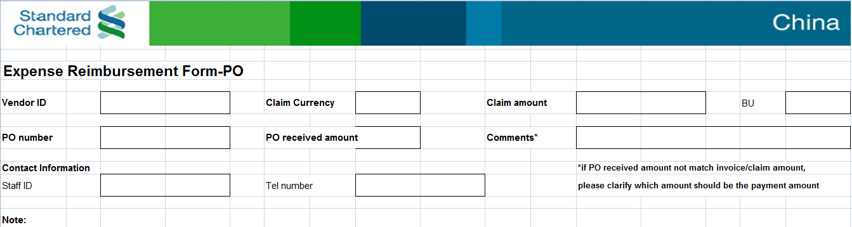
Current Business Workflow
AO
Requestor
Notes:
In this case, our user is from AO department, their job is payment. Currently, they always manual to input invoice information and verify it within BRCC data. I will show you what ‘s the BRCC later.
AO staff will register this invoice information into system and then trigger to verify it with BRCC data.
For verification invoice, AO staff will scan the invoice for backup and transfer it to Indexer Department.
AO staff will send email to BRCC, and tell them which invoice is verified, which one is not.
Requester must fill in payment excel and then print it out. And then post it to AO within the invoice. For example, you have business travel to SG, when you are back, you have to fill in the payment excel and then post your hotel invoice, and submit to your HR. and HR will help you transfer to AO.

Slide 4

Current Business Workflow
AO
Indexor
Register Invoice
Verify By BRCC
Soft Copy Invoice
Stakeholder
email feedback
Notes:
AO staff will register this invoice information into system and then trigger to verify it with BRCC data.
For verification invoice, AO staff will scan the invoice for backup and transfer it to Indexer Department.
AO staff will send email to BRCC, and tell them which invoice is verified, which one is not.

Slide 5
Current Business Workflow
In above description, the draft estimation is that:
For AO Department:
Manual register: 25s * 2000 / month
Manual soft copy: 3s * 3 * 2000 / month
Communicate with stakeholder: 7 hour / month
Manual mistake : 3%
For Trade Department :
it will cost 119 hours / month.
Notes:
AO staff will register this invoice information into system and then trigger to verify it with BRCC data.
For verification invoice, AO staff will scan the invoice for backup and transfer it to Indexer Department.
AO staff will send email to BRCC, and tell them which invoice is verified, which one is not.

Slide 6
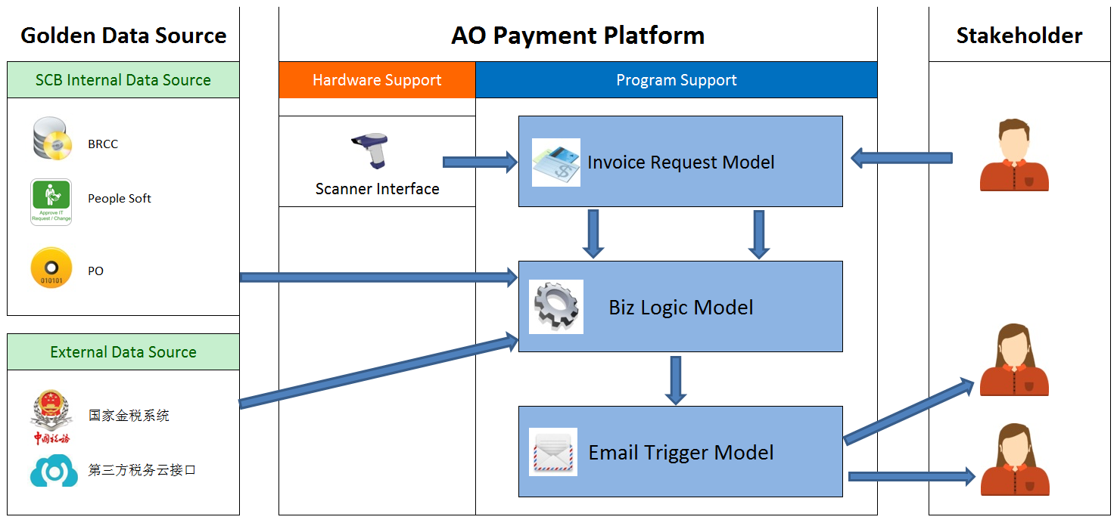
New Design
e-Form Application

Slide 7

New Design

Slide 8
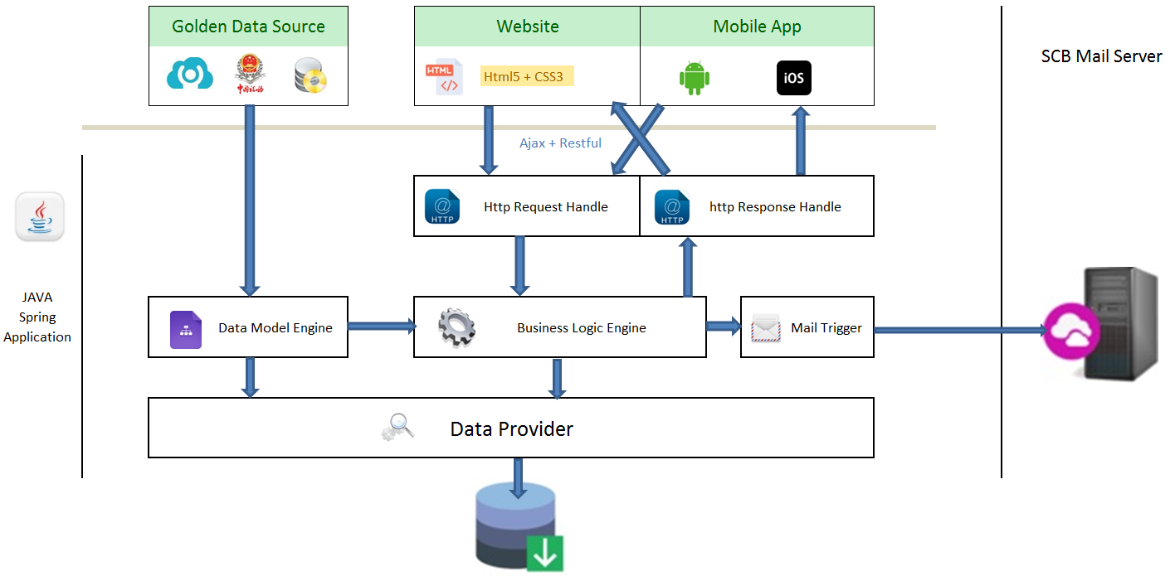
New Design

Slide 9
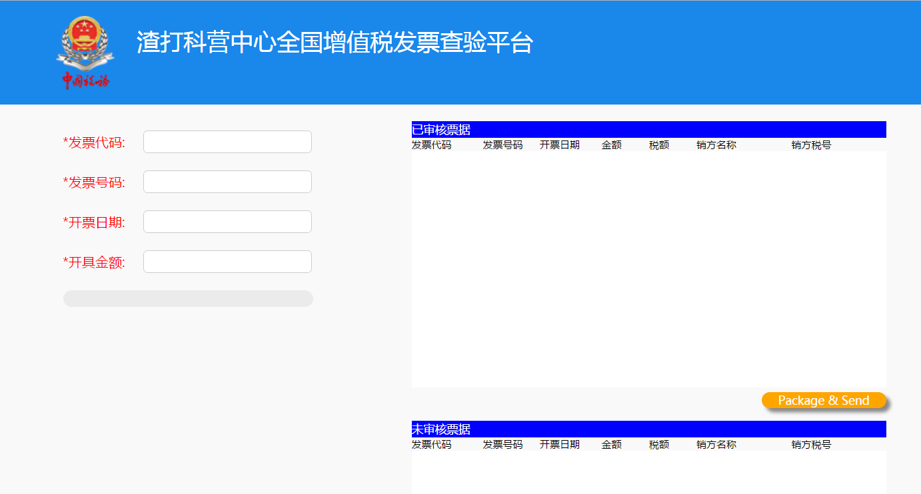
Demo

Slide 10
Q&A

